Slide 1

Welcome
to
HTML PROBLEMS
by
MD : RAHATUL ISLAM
B.Sc. Engineering Dept. of Ice at PUST.
Gmail ID :rahatul.ice.09.pust@gmail.com
Mobile No : 017902-24950

Slide 2
HTML Programs
Problem - 1

Slide 3
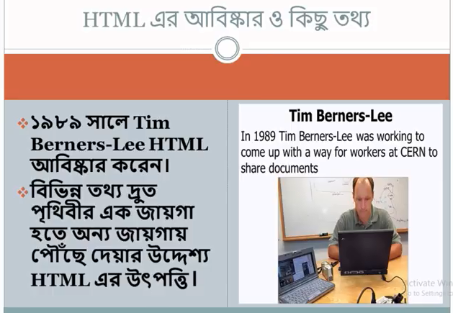
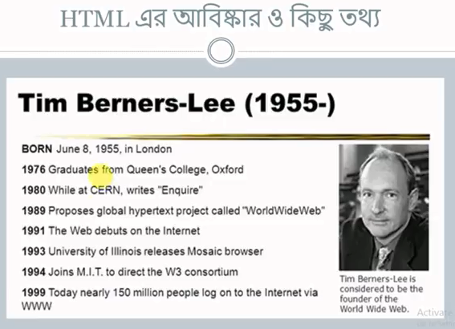
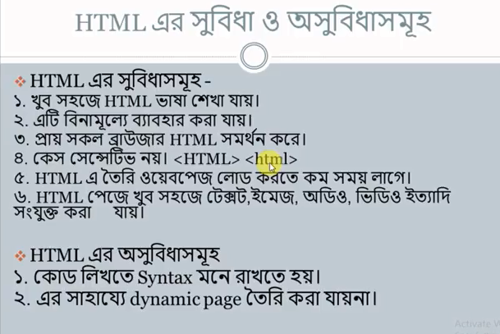
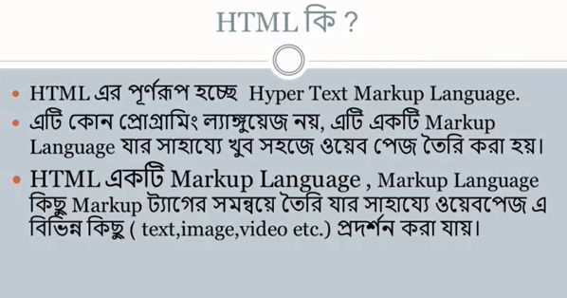
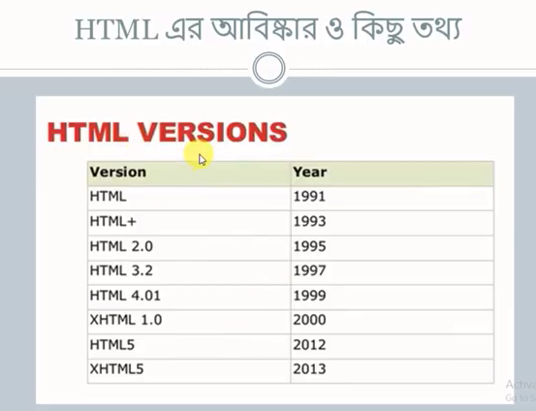
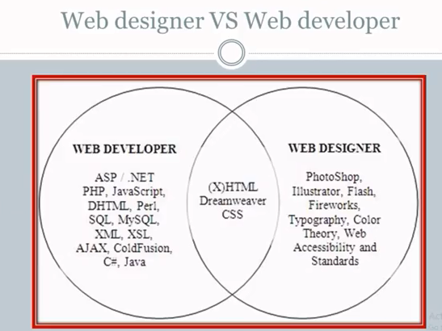
Introduction of HTML

Slide 4
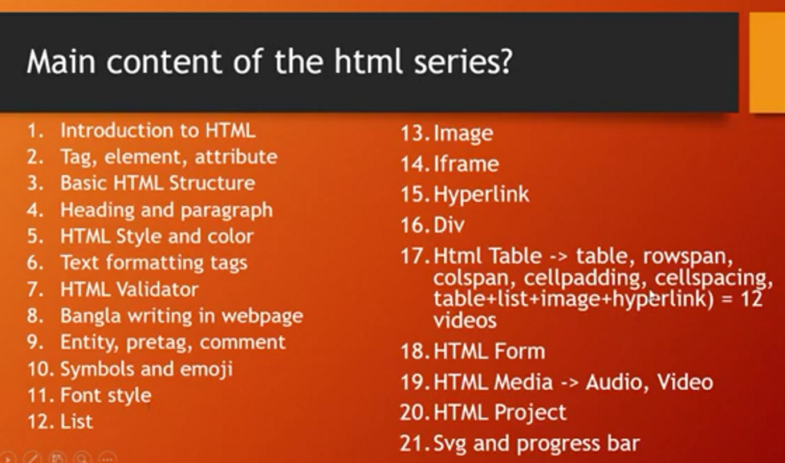
Main Contain of HTML

Slide 5
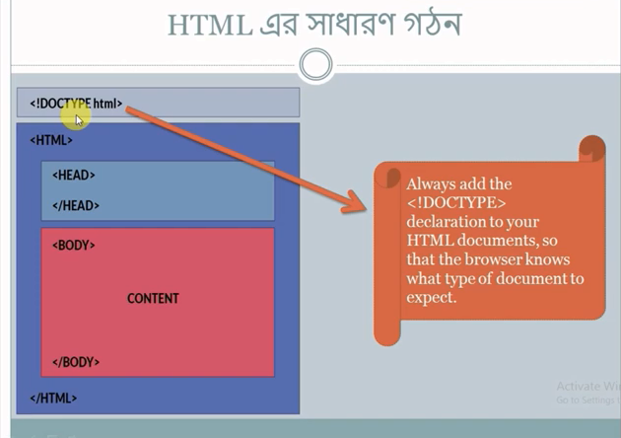
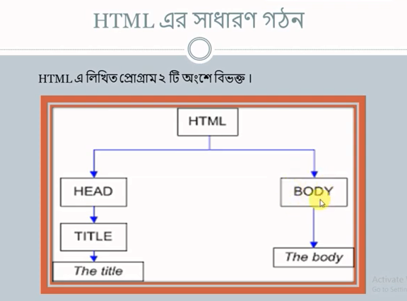
Basic Structure of HTML

Slide 6
HTML Programs
Problem - 2

Slide 7
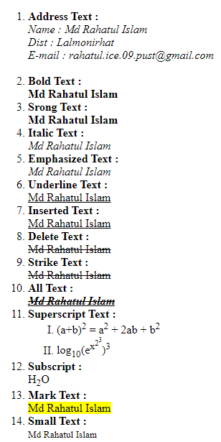
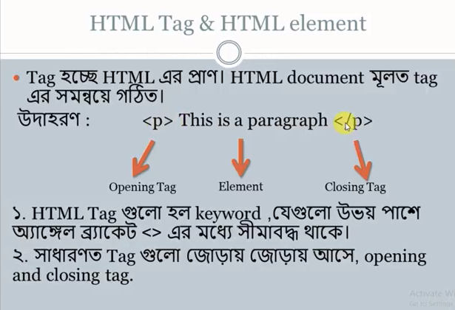
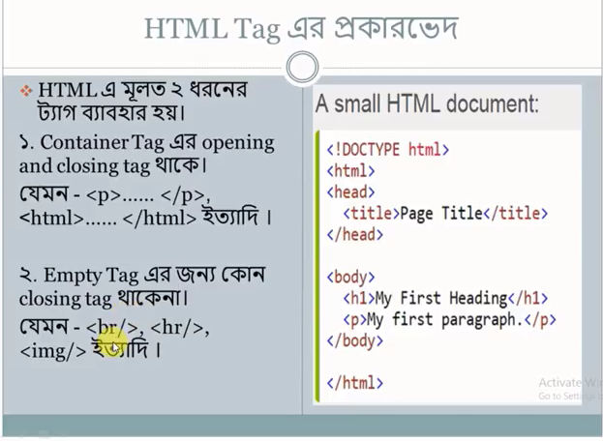
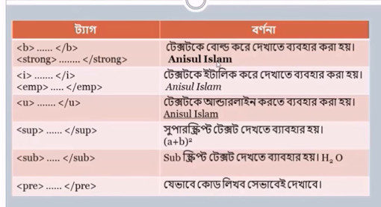
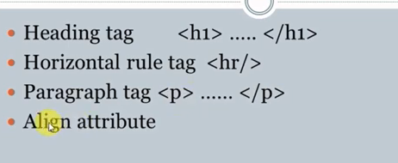
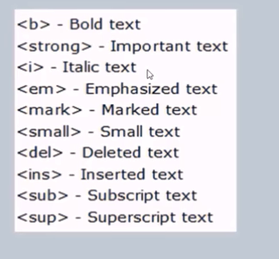
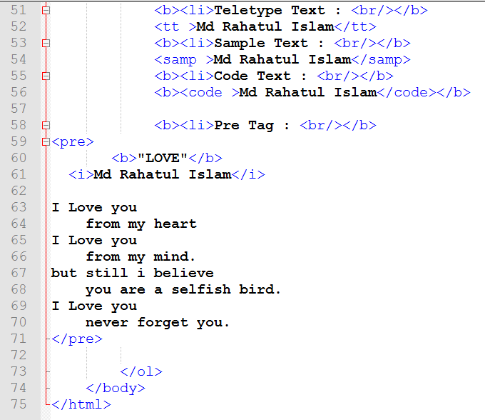
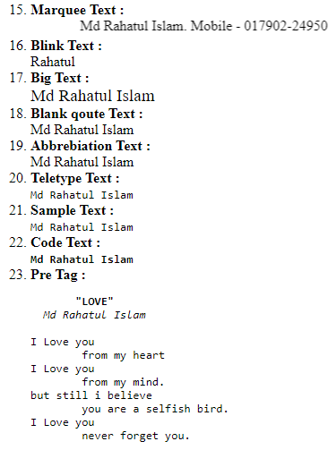
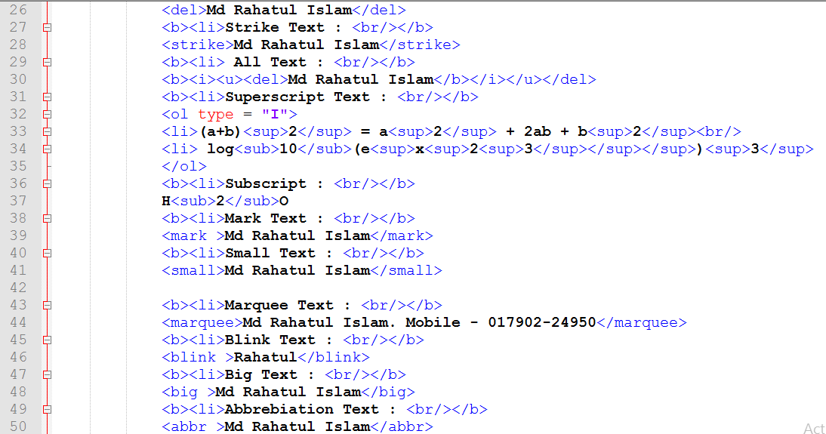
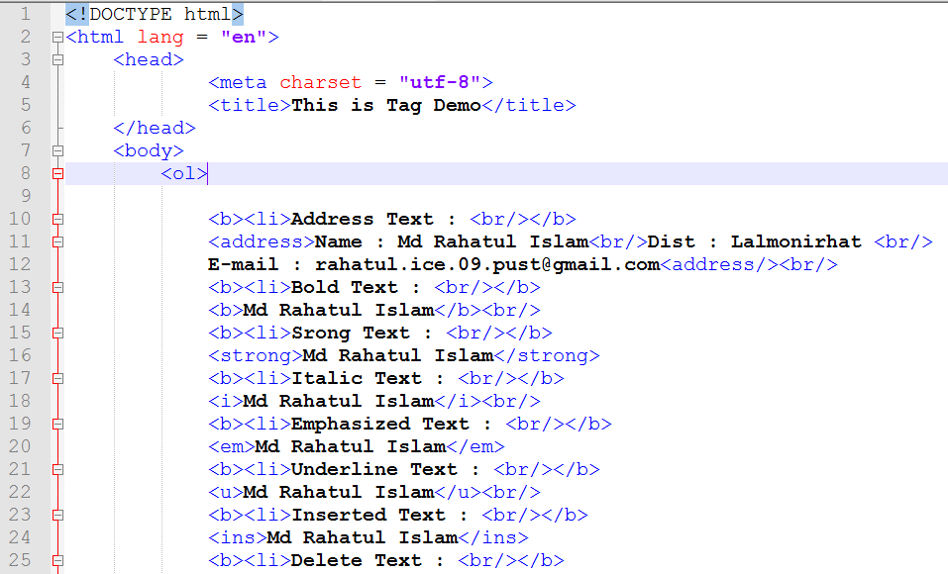
Tag & Elements of HTML
<Example>
<Output>
2
1
1
2
3

Slide 8
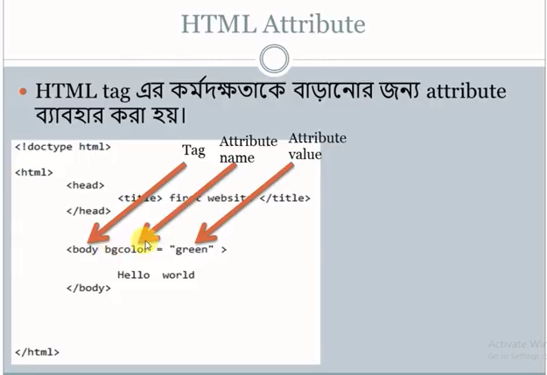
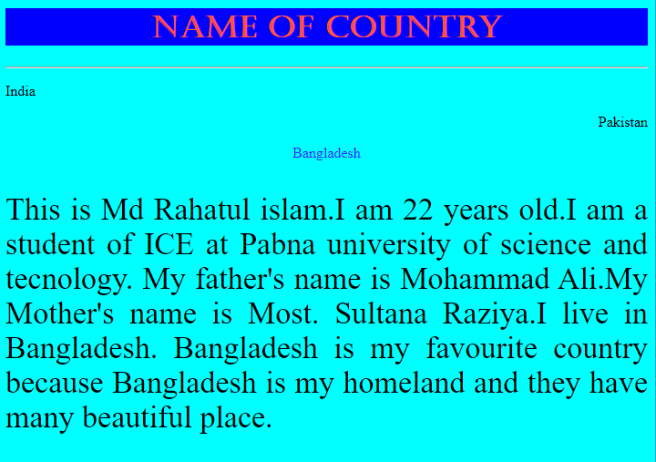
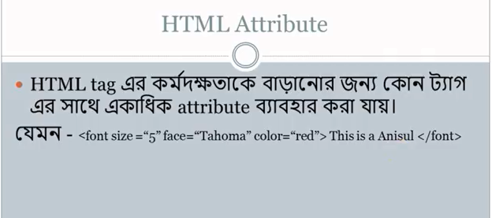
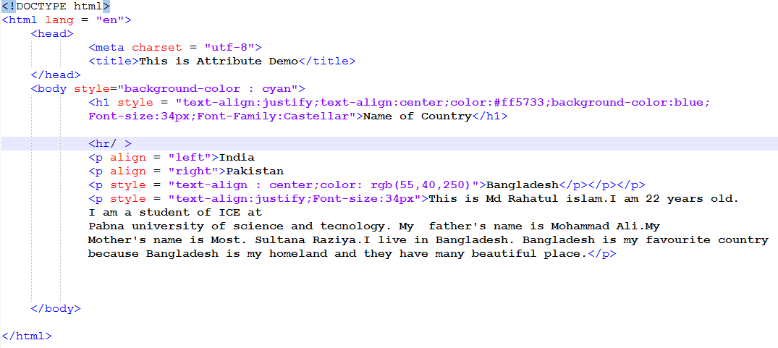
Attribute of HTML
<Output>
<Example>
Style =“text-align:center ;Font-size:34px;Font-Family:Castellar;width:34px;height:22px;Bancground-color:red;color:blue”

Slide 9
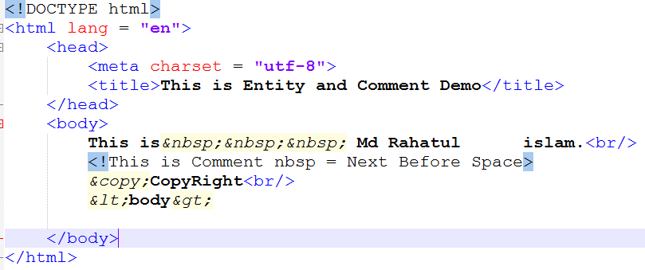
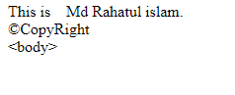
Entity & Comment of HTML
<Example>
<Output>
Entity is a symbol of imaginary subject. Visible in the webpage Many symbol such as-copyright, less than etc. known as about Entity.
The part’s of three of Entity.
Every Entity start with sign of ampersand (&).
Then name of Entity such – copy.
The end with sign of semicolon (;).
Example - &copy;
Comment Demo of HTML <!--This is HTML Comment demo-->

Slide 10
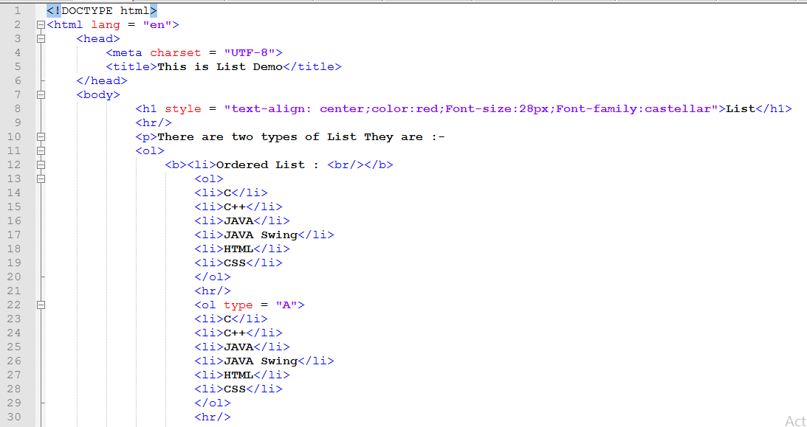
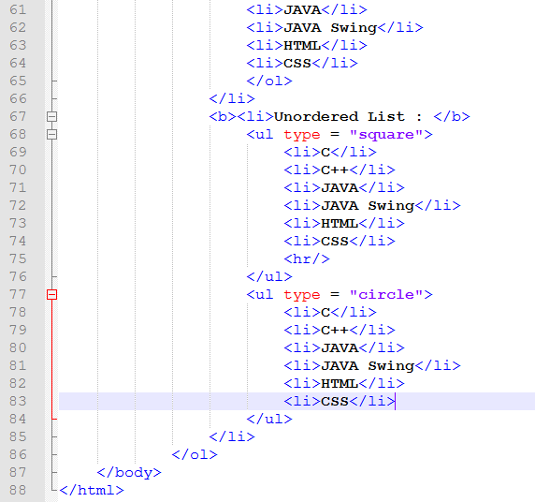
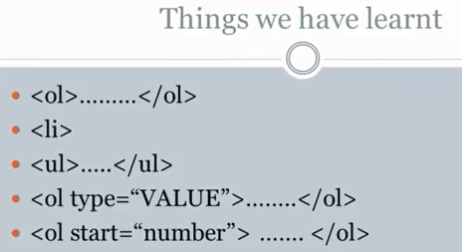
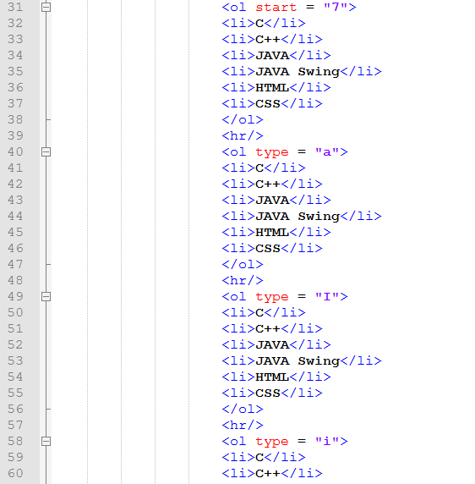
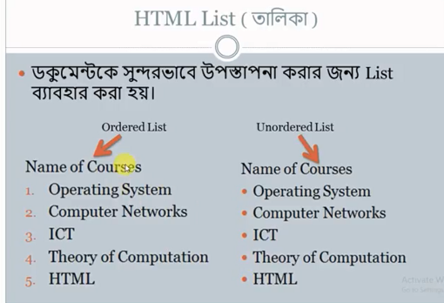
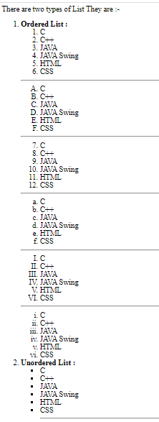
List of HTML
<Example>
<Output>
3
2
1

Slide 11
HTML Programs
Problem - 3

Slide 12
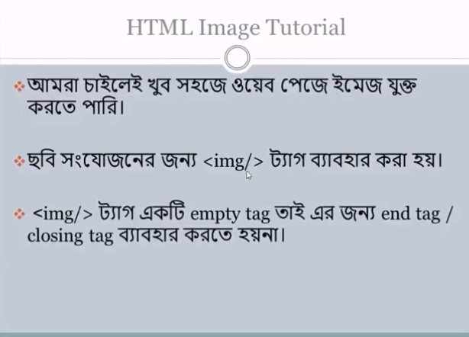
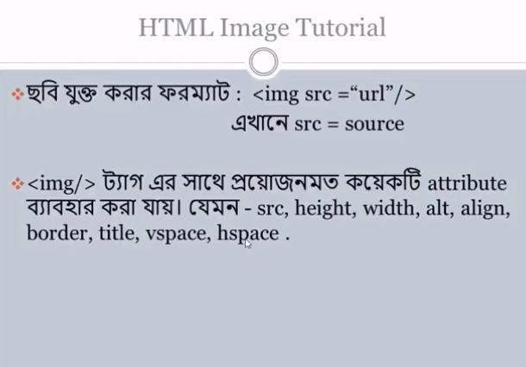
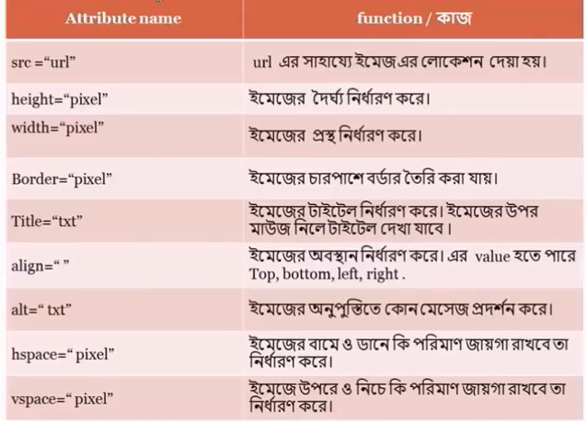
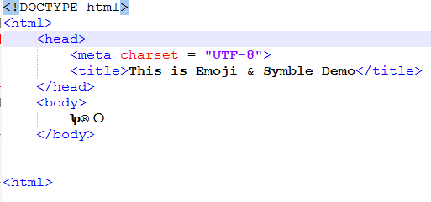
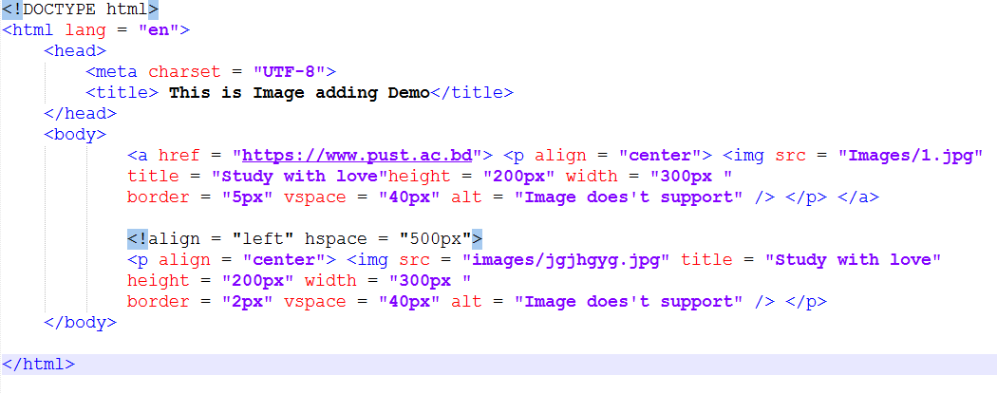
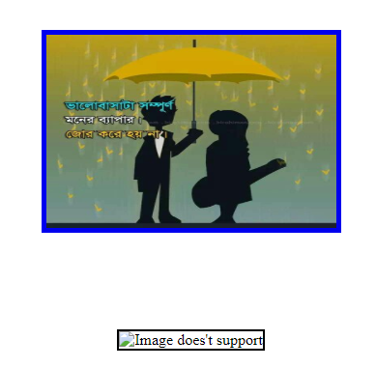
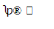
Image adding of HTML
<Output>
<Example>

Slide 13
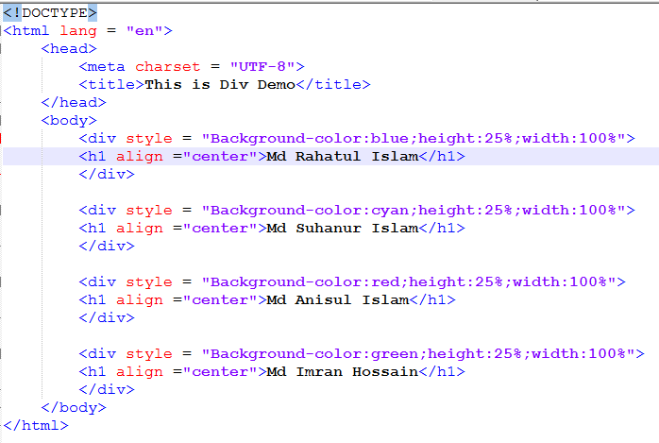
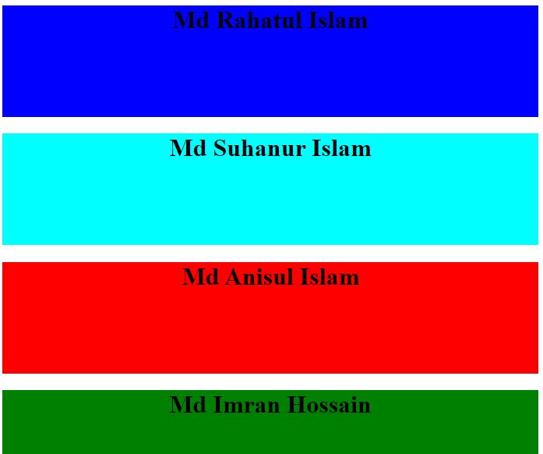
div of HTML
<Example>
<Output>

Slide 14
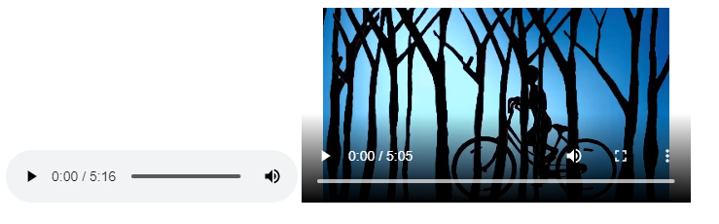
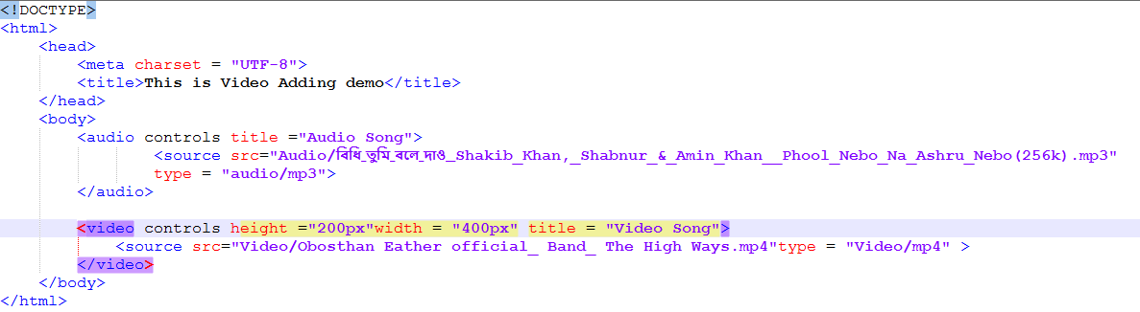
Audio & Video of HTML
<Output>
<Example>

Slide 15
HTML Programs
Problem - 4

Slide 16
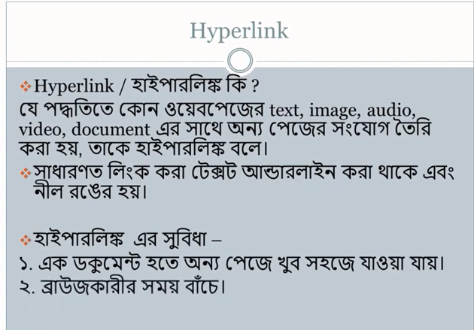
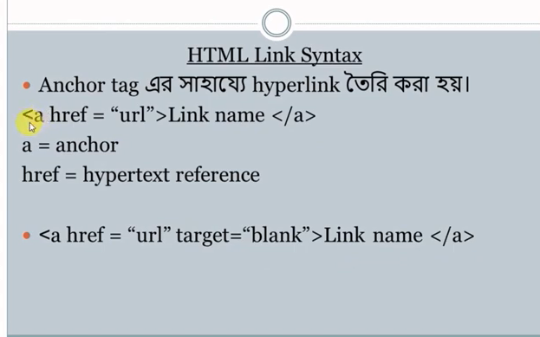
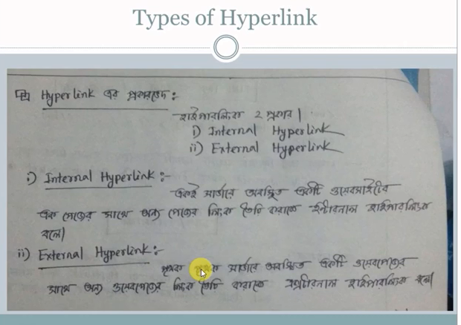
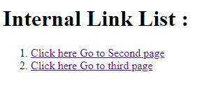
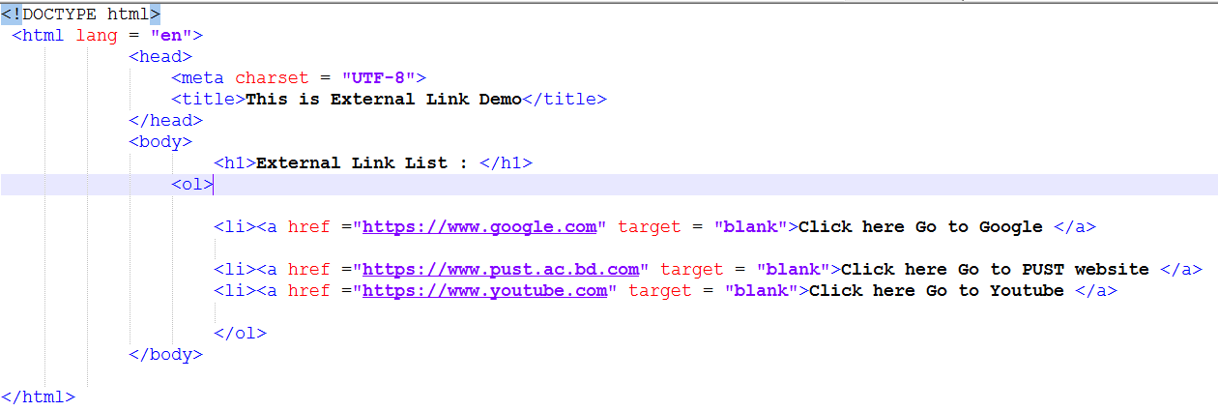
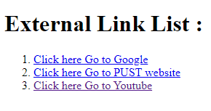
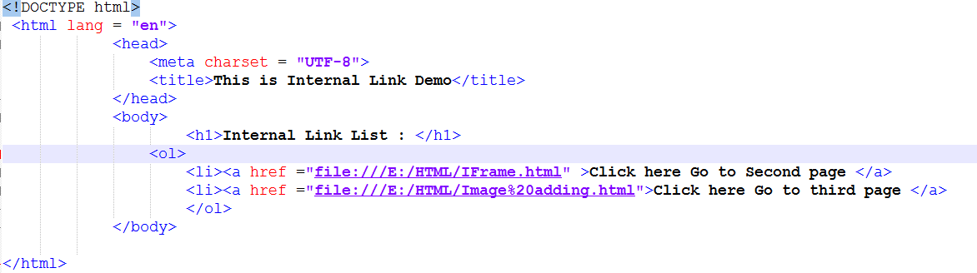
Hyperlink of HTML
<Output-2>
<Example-2>
<Output-1>
<Example-1>

Slide 17
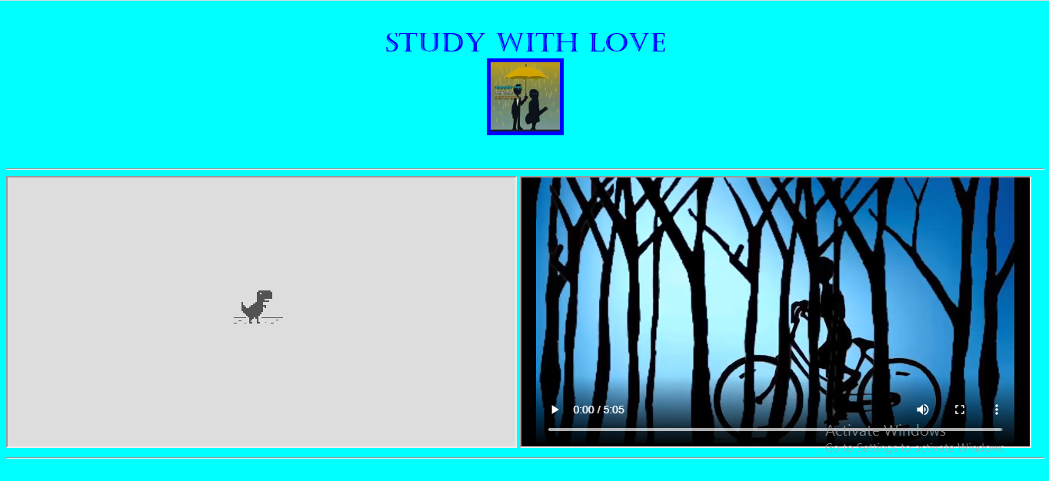

IFrame of HTML
<Example>
<Output>

Slide 18
HTML Programs
Problem - 5

Slide 19








Table of HTML
<Output-3>
<Output-1>
<Example-1>
<Example-2>
<Output-2>
<Output-4>
<Ezample-4>
<Example-3>

Slide 20
HTML Programs
Problem - 6

Slide 21







Form of HTML
<Example>
<Output>
1
3
2

Slide 22
Reference by
www.w3School.com

Slide 23




